Slide 1
SMART Home
Group 2:
John Satterla (Team Lead) – Computer Engineer – Wireless Connectivity
Zachary Eakerns – Electrical Engineer – Biomedical Hardware
Zarka McClung – Computer Engineer – SMART Appliances
Christian Jensen – Electrical Engineer – Interfacing and Power

Slide 2
Project Description
Our system will monitor a patient's position, and the environment around them will react to their movements. A station will be located in the home to monitor the user’s vitals including EKG, oxygen in their blood, and their heart rate. The “room” will have 2 major appliances that are activated via facial or voice recognition. Lights and other items will turn on as the user moves throughout the “room”. There will be a door that is automatically opened when the user is trying to enter the room.

Slide 3







System Overview
BLE Beacons
Facial Recognition/ Voice Command for door and 2 TBD appliance
Television
Wireless Patient Monitor
Central processing station receives and displays data from user and devices
via TBD wireless technology
Determines position in Room from BLE Beacons
Sends user data to central processing station for monitoring and web via TBD wireless protocol
Door
Lights throughout
Fan
Room/Space Dimensions TBD
John Satterla

Slide 4
BLE Beacons for Location Tracking
Bluetooth low energy (BLE) beacons can be used as both connectable and non-connectable beacons to display information for applications such as asset tracking, advertisements, etc. [7]
We plan to use beacons to calculate proximity of the user monitor to enable proximity based devices such as lights and or fans
This can be done by receiving data from advertisement packets from the beacons and analyzing RSSI data on the fly
RSSI – relative received signal strength
[7]
Example BLE Packet with RSSI
John Satterla

Slide 5
BLE Beacons – Hardware Block Diagram
Wireless MCU
Debug Interface
Battery
RF
Power Management
Interface to Appliances/Lights/
Devices
PCB or Chip Antenna
Power
RF or Serial Communication
John Satterla

Slide 6
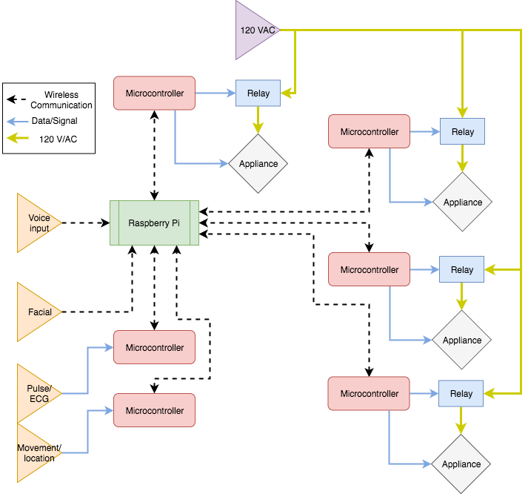
Hardware Diagram

Slide 7
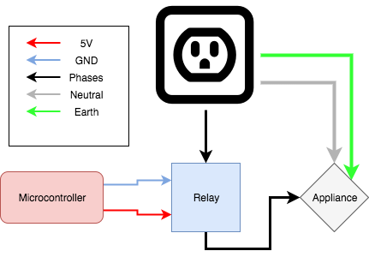
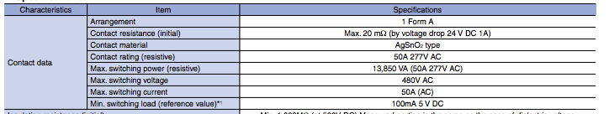
Relay– MCU to Appliance Power Method
Relay Minimum Specifications:
Switching Voltage:
120 Volts @ 10 Amps
Coil Voltage:
5 Volts
Subject to change based on MCU maximum Vout
Researching:
Circuit Protection
Switching using a transistor
Panasonic ADJH22005
[1]
[1]

Slide 8

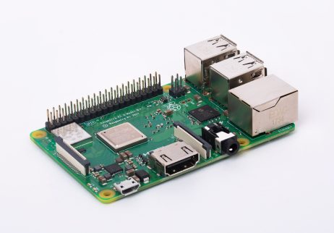
Raspberry Pi – Main Physical Control
Open source home automation software
Bluetooth support
Multi accessory support
Can perform actions based on inputs
Must support custom accessories
[4]
Pi B+ specs:
2.4GHz/5GHz IEEE 802.11.b/g/n/ac
Bluetooth 4.2
4 × USB 2.0 ports
1 × full size HDMI
MIPI DSI display port
MIPI CSI camera port
[11]

Slide 9
Electrocardiograph
Anywhere from a 100 µV to 2 mV of voltage can be detected across the skin of a person due to heart muscles depolarizing
Using electrodes, a computer can graph this information in real time to produce an electrocardiogram (ECG or EKG)
Monitoring a person's EKG can ensure the patient has a strong regular heartbeat while also giving the patient’s heart rate

Slide 10
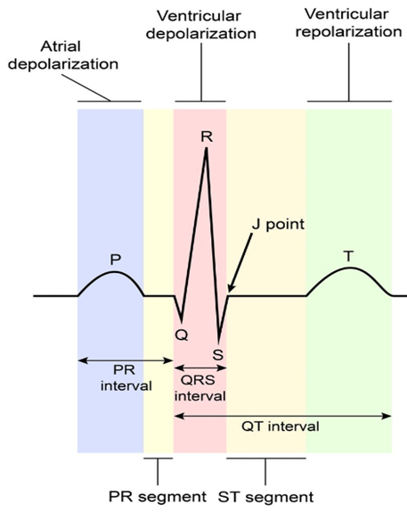
EKG Example
This is the image of an ideal EKG signal
Heart rate can be found by tracking the frequency of the QRS interval
Atrial repolarization does occur, though it happens during the ventricular depolarization which dwarfs the atrial repolarization signal causing it not to be seen
[9]

Slide 11
How To Capture EKG Signals
As mentioned previously, the voltages across the skin are 2 mV or smaller in magnitude
Amplification of at least 500 times the original signal is needed in order for the EKG to be made
However, amplifying the EKG signals can create issues

Slide 12
Problems With Amplification
The human body acts as one large antennae, picking up noise that will be amplified along with the desired signal
The biggest source of interference is 50-60 Hz signals coming off of transmission lines
To alleviate this issue, a lowpass filter with a cut off of approximately 35-40 Hz is needed

Slide 13
AD624 Precision Instrumentation Amplifier
Can be set to a gain of 500 with very little error (0.25%)
Typical supply voltage is 15 V
Quiescent current of 3.5 mA
Internal power dissipated is a max of 420 mW
[2]

Slide 14
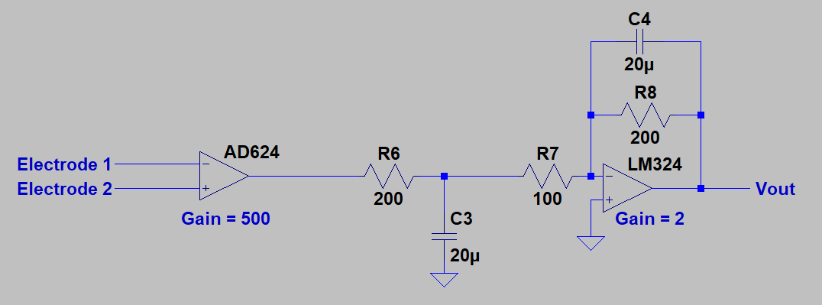
EKG Circuit Schematic

Slide 15
Pulse Oximetry
Another important vital to monitor is arterial oxygen levels
This information is displayed as a number between 0 and 100%, with readings for a healthy patient reading residing anywhere from 95-100%
A value of less than 90% is considered low

Slide 16
Pulse Oximetry Continued
The value found is the patient’s peripheral capillary oxygen saturation, or Sp02
Sp02 is used as a quick estimate, and can vary from the patient’s actual saturation levels by as much as 2%
For example, a patient’s oximetry reading might be 98% meaning 98% of each red blood cell is oxygenated, though the actual value could be as low as 96% or as high as 100%

Slide 17
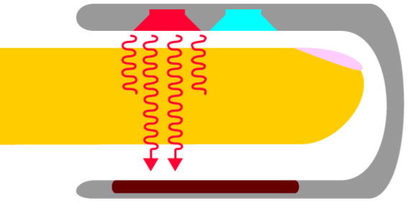
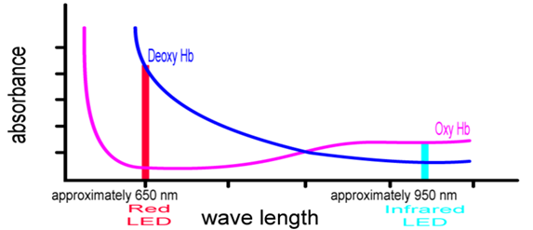
Measuring Blood Oxygenation
By shining a red light and an infrared light through an area on a patient containing an artery, the Sp02 level can be found by comparing the ratio of red light absorbed to infrared light absorbed
Oxyhemoglobin absorbs more infrared light, while deoxyhemoglobin absorbs more red light
[6]
[6]

Slide 18
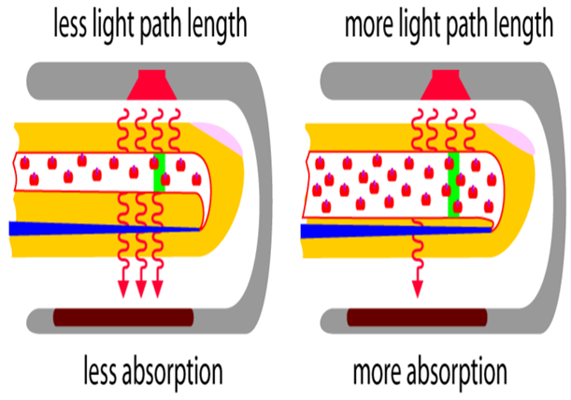
Where To Measure From
The best place to attach an oximetry device is still being researched, though conventionally a finger has been used
Lambert’s Law, which states the amount of light absorbed is proportional to the length of the path that the light has to travel in the absorbing substance, gives an argument as to why a finger might not be the best option
Other issues when using a finger is possible poor circulation and tremors
Initial oximetry readings will be through the finger, though this may change if readings prove inaccurate
[6]

Slide 19
Calibration
Because blood is not a still, neat red liquid light that passes through it tends to scatter
For this reason Lambert’s Law and Beer’s Law, which states the amount of light absorbed is proportional to the concentration of the light absorbing substance, cannot be applied directly
Instead calibration is needed in order to ensure the oxygenation device is working properly

Slide 20
Other Issues
As mentioned, oximetry works by measuring the ratio of light allowed to pass through
However ambient light can create “noise” that will interfere with readings
To fix this, the two LED’s are never on at the same time, and instead alternate with a span where both are off and only ambient light is measured
By doing this, ambient light can be calculated and accounted for

Slide 21
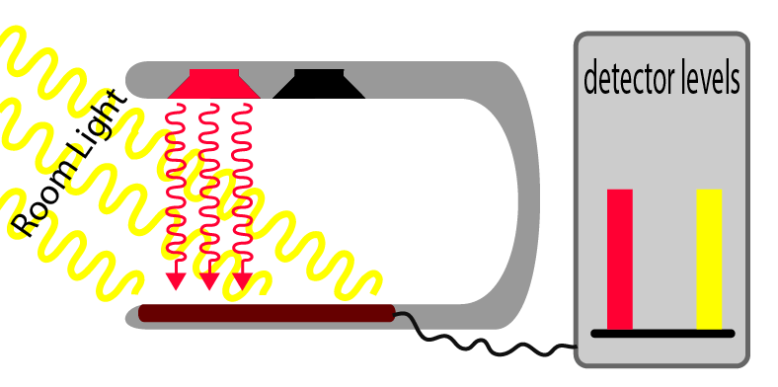
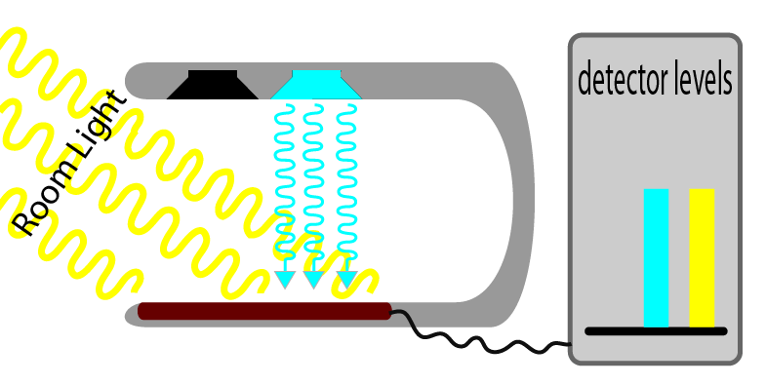
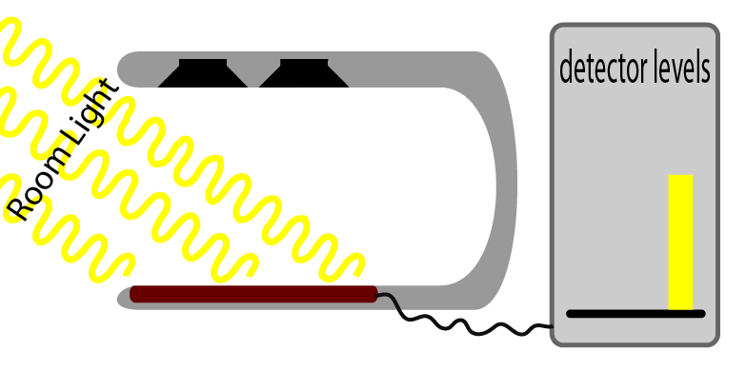
[6]

Slide 22
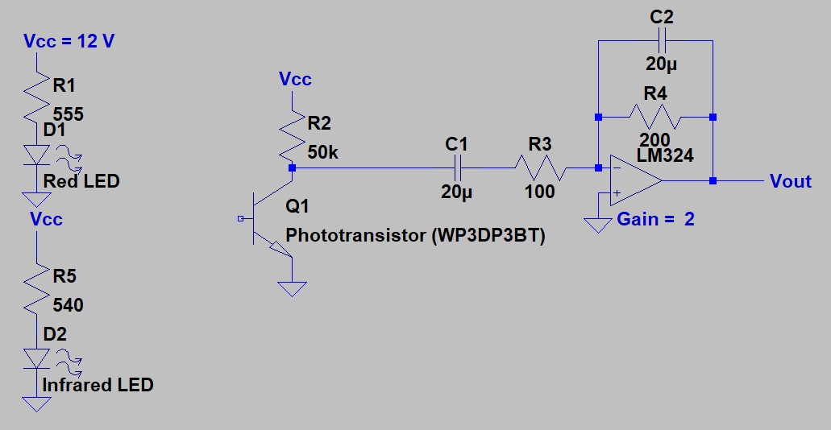
Pulse Oximeter Schematic

Slide 23
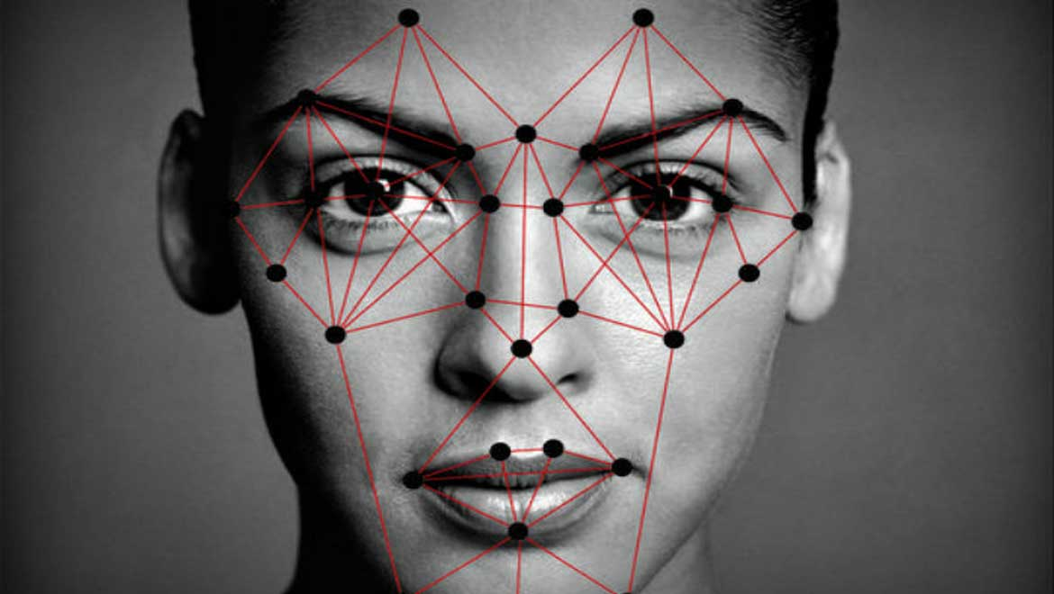
Face Recognition Door
Every face has numerous, distinguishable landmarks, the different peaks and valleys that make up facial features. Our face defines these landmarks as nodal points. Each human face has approximately 80 nodal points. Some of these measured by the software are:
Distance between the eyes
Width of the nose
Depth of the eye sockets
The shape of the cheekbones
The length of the jaw line
These nodal points are measured creating a numerical code, called a faceprint, representing the face in the database.
[6]

Slide 24
Facial Recognition Phases
Phase I: Data Gathering
Gather face data (images) of the person to be identified
Phase II: Store Data
Data needs to be stored in a database (a dataset of images)
Phase III: Train the recognizer
Phase IV: Recognition
It will differentiate between two faces and allow only verified user to proceed
Feed that face data and respective id’s of each face to the recognizer so that it can learn

Slide 25
Preliminary Hardware list
Preliminary Software list
Rasberry Pi 2 Model B
Doorbell (Push button)
12-Volt DC Electric Door Strike
2-Channel 5V Relay Module
12V 5A Switching Power Supply (Anything above 3A should work. Must be 12V)
Microsoft Lifecam 3000
Generic Speakers
Microsoft Windows 10 IoT Core
Microsoft Azure (Planning to use Microsoft Face APIs hosted by Azure) *Face API – free (Up to 20 transactions per minute, 30,000 transactions free per month)
Microsoft Visual Studio for codes
This part of the project will utilize a Raspberry Pi, basic Webcam, and an internet connection to create a door that unlocks itself via facial recognition. If the visitor at the door is recognized, the door will unlock!
[3] [10]

Slide 26


Door system overview
Access Granted
Step 1: Position the registered user in front of the webcam and press the physical "doorbell" button.
Step 2: You should hear audio feedback informing you that the door has been unlocked!
Step 1: Now try pressing the doorbell button when an unregistered user is in front of the door.
Step 2: You should hear audio feedback informing you that the door has detected a stranger and will not unlock!
Access Denied
[3]

Slide 27






Voice Recognition for Appliances (temporary idea)
Stream music from YouTube through speakers
Signal sent Wirelessly to Speakers or TV (Bluetooth or WiFi)
Signal sent to RaspberryPi
RaspberryPi determines which appliance to turn on
Voice command received from a person
Turn on TV/ Monitor

Slide 28
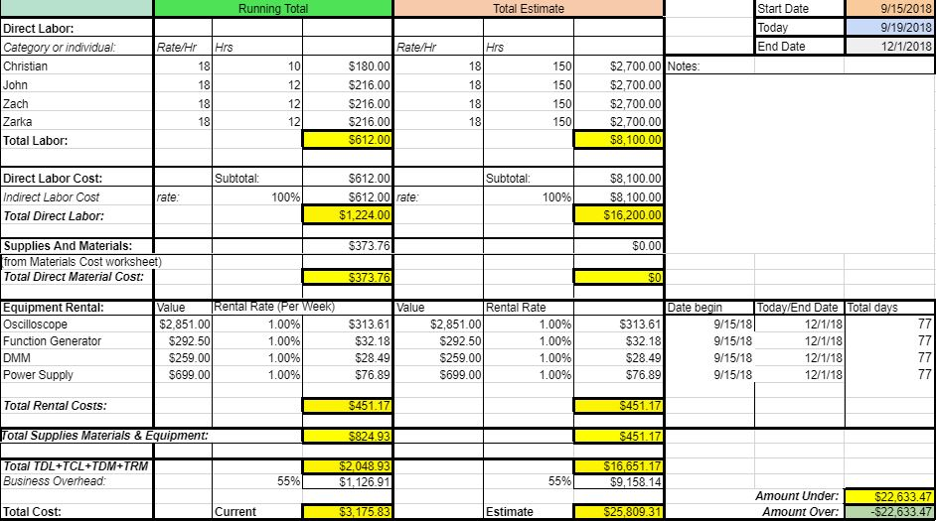
Budget

Slide 29
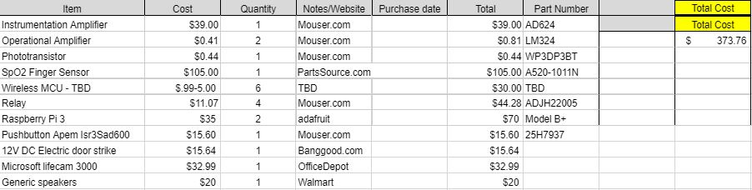
Materials

Slide 30
Deliverables for Next Week
John Satterla
Zachary Eakerns
Zarka McClung
Christian Jensen
Finalize wireless communication protocols and begin hardware selection
See if on hand wireless devices are suitable for BLE beacon application
Finalize values for lowpass filters and types of amplifiers
Find out how to extract Sp02 value from readings
Finalize which appliances to use
Select connectivity options (Bluetooth Vs WiFi)
Start researching and writing code for face recognition
Design and order parts for relay circuit
Research Raspberry Pi Smart home front ends

Slide 31
Reference
"ADJH22005 Datasheet“[Online]. Available: https://www.mouser.com/datasheet/2/315/mech_eng_djh-1129317.pdf. [Accessed: 18-Sep-2018].
“AD624 Precision Instrumentation Amplifier Data Sheet.” [Online]. Available: http://www.analog.com/media/en/technical-documentation/data-sheets/AD624.pdf. [Accessed: 18-Sep-2018].
E. Kusters, “ Windows IoT: Facial Recognition Door,” Hackster.io, 27-Dec-2017. [Online]. Available: https://www.hackster.io/windows-iot/windows-iot-facial-recognition-door-e087ce. [Accessed: 19-Sep-2018].
”Home page” [Online]. Available: https://www.home-assistant.io/. [Accessed: 18-Sep-2018].
“How Facial Recognition Systems Work.” . http://www.oamk.fi/~palo/iten1/19_EXTRA_Facial Recognition Systems.pdf
“How pulse oximeters work explained simply.,” How Equipment Works. [Online]. Available: https://www.howequipmentworks.com/pulse_oximeter/. [Accessed: 18-Sep-2018].
J. Lindh, “Bluetooth® low energy Beacons,” ti.com, Oct-2016. [Online]. Available: http://www.ti.com/lit/an/swra475a/swra475a.pdf. [Accessed: 17-Sep-2018].
“LM324 Datasheet.” [Online]. Available: http://www.ti.com/lit/ds/symlink/lm324.pdf. [Accessed: 18-Sep-2018].
M. Dominguez, “Electrocardiogram (ECG),” MedBullets. [Online]. Available: https://step1.medbullets.com/cardiovascular/108017/electrocardiogram-ecg. [Accessed: 18-Sep-2018]
“Pricing - Face API | Microsoft Azure,” A beginner's guide | Microsoft Azure. [Online]. Available: https://azure.microsoft.com/en-us/pricing/details/cognitive-services/face-api/. [Accessed: 19-Sep-2018].
“Products.” [Online]. Available: https://www.raspberrypi.org/products/. [Accessed: 18-Sep-2018].
“WP3DP3BT Phototransistor Datasheet.” [Online]. Available: https://www.kingbrightusa.com/images/catalog/spec/WP3DP3BT.pdf. [Accessed: 18-Sep-2018}.

Slide 32
Questions?

